Slide 1

Quality Alloy INC Promotion Analysis
Team 2:
Valentino Michelle Gabriela Jiwei Li Ankur
Feb 2019

Slide 2
Executive SUmmary
Promotion delivered to more visits to the web site
Promotion did not have a positive impact in revenues (sales)
Promotion did not have a positive impact in profits or margins
Bad Data Quality (High Bounce Rate)
Focus on (demographic data):
Main Referring Sites (56% of total visits):
Google 79%
Main Search Engines (30% of total visits):
Google 85%
Main Markets:
South America (34%)
Northern America (27%)
Central America (10%)
Notes:
Drive new sales
Make product and contact information available
Give or add legitimacy
- Using the analysis form the data available we can say that the promotion was not good, because despite the fact the company receives more unique visits the pounds sold, revenue and margin went down in the promotional period.
- The pre promotional period, with less visits reflects more revenues and more margin.
We can see that clearly the promo had no effects in terms of sales but had an effect in terms of visits to the website. Gave visibility buy not conversion to sales. RECOMMENDATION: try to make the website more engage to the people that visits it.
Also we can see that the bounce rate is quite high during the promotion period (77%) against the pre-promotion period (65%) which means the lists purchased for 25K wasn’t of a good quality. RECOMMENDATION: review the lists purchased in order to be sure they are of a good quality, ad ensure a low bounce rate, to make a better impact.
FURTHER EXPLORATION:
We don’t’ exactly where the sales (revenues) came from , we need more data collection here to see if actually the ones that are buying are new customers who enter through the web or if they are current customers, need to have the distribution of sales.
LOOK FOR THE VARIATION IN THE PRICE OF METALS AND WHO THIS IMPACT THE REVENUES
CONVERTION TO SALES FROM THE TRAFFIC SOURCES
CHARTS NEEDED:
HORIZONTAL BAR CHART WITH THE DEMOGRAPHICS ABOUT VISIT FROM THE WEB SITES AND THE REGIONS
WHERE TO FOCUS WITH THE REGIONS, AND THE WEBS THAT WE USE TO ADD

Slide 3
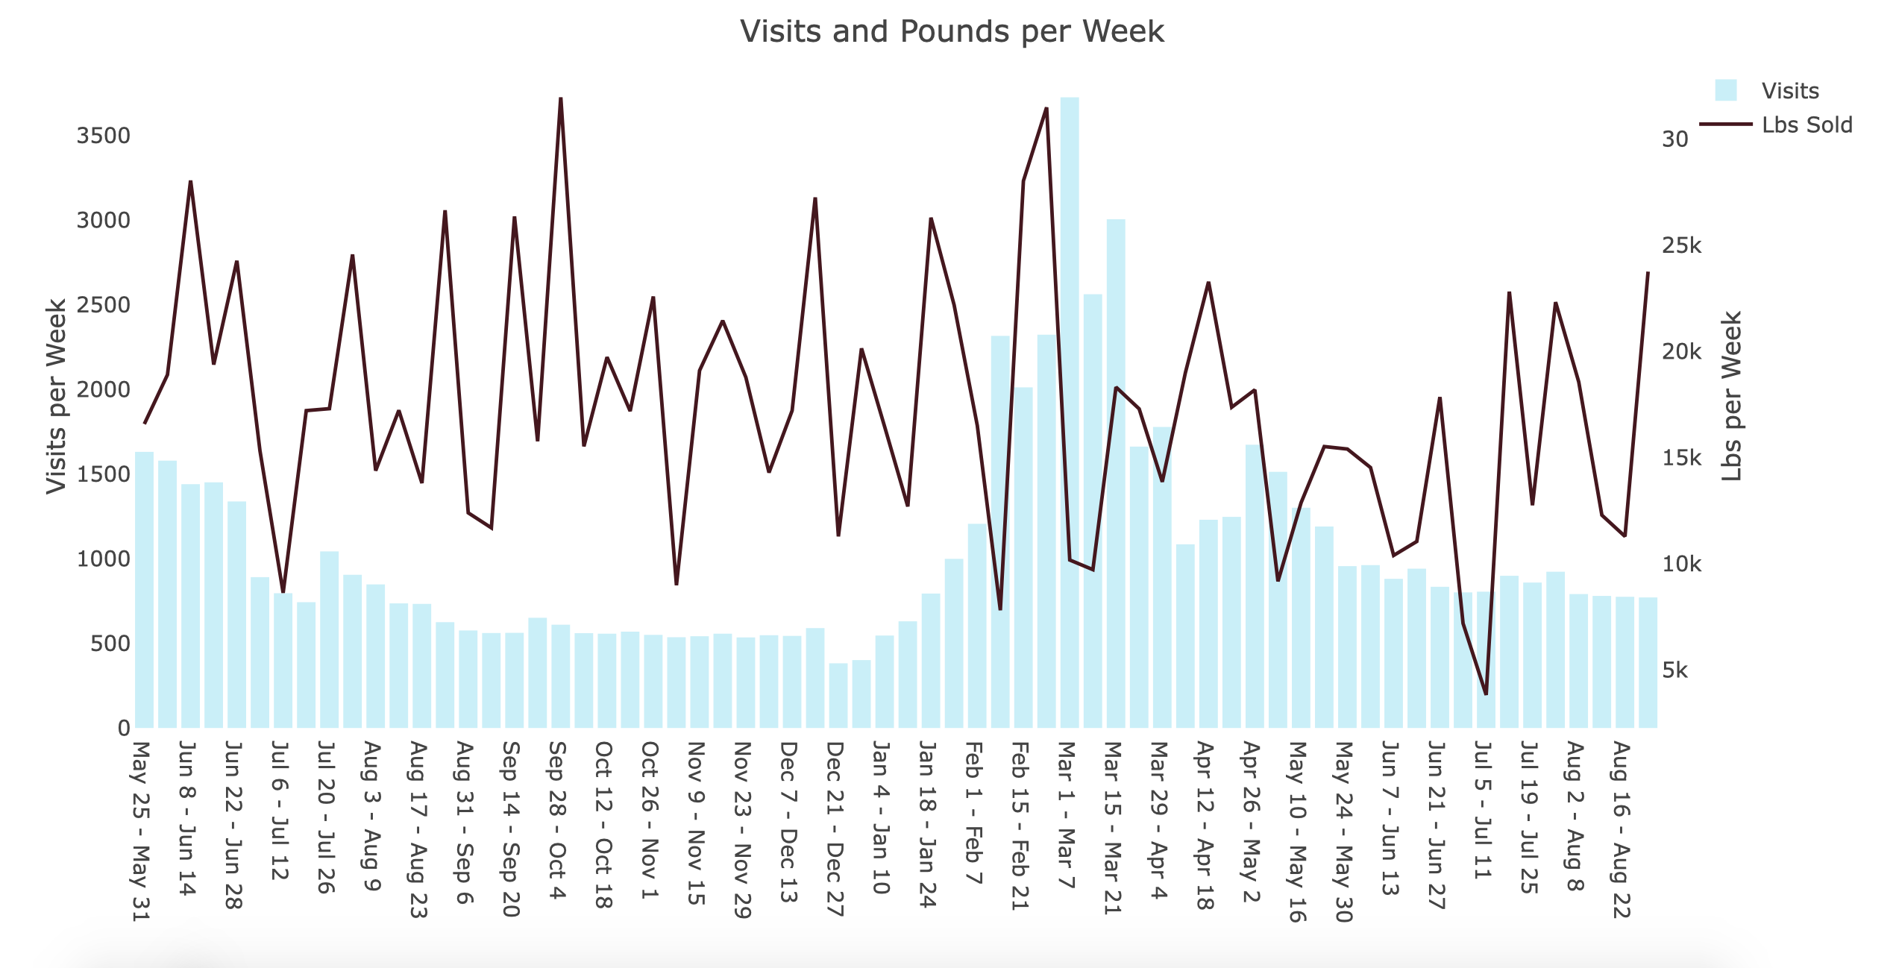
Web site visits overview
Amount of the weekly visits per period
Initial
Pre-Promo
Promo
Post-Promo
Source: Columbia Business School - Web Analytics at Quality Alloys, Inc.
Source: Columbia Business School - Web Analytics at Quality Alloys, Inc.

Slide 4
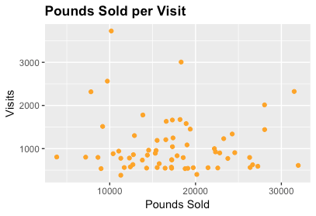
RELATIONSHIP BETWEEN POUNDS SOLD & WEEKLY VISITS
As we can see in the chart there is no obvious relationship between the pounds sold and visits.
More visits are not driving up the sale of the alloys
Source: Columbia Business School - Web Analytics at Quality Alloys, Inc.

Slide 5
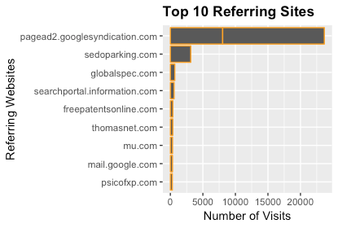
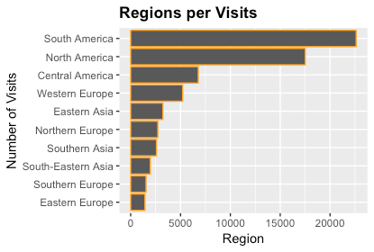
Demographic data
Where to Focus the Attention
Source: Columbia Business School - Web Analytics at Quality Alloys, Inc.
Notes:
Overview of the website info

Slide 6
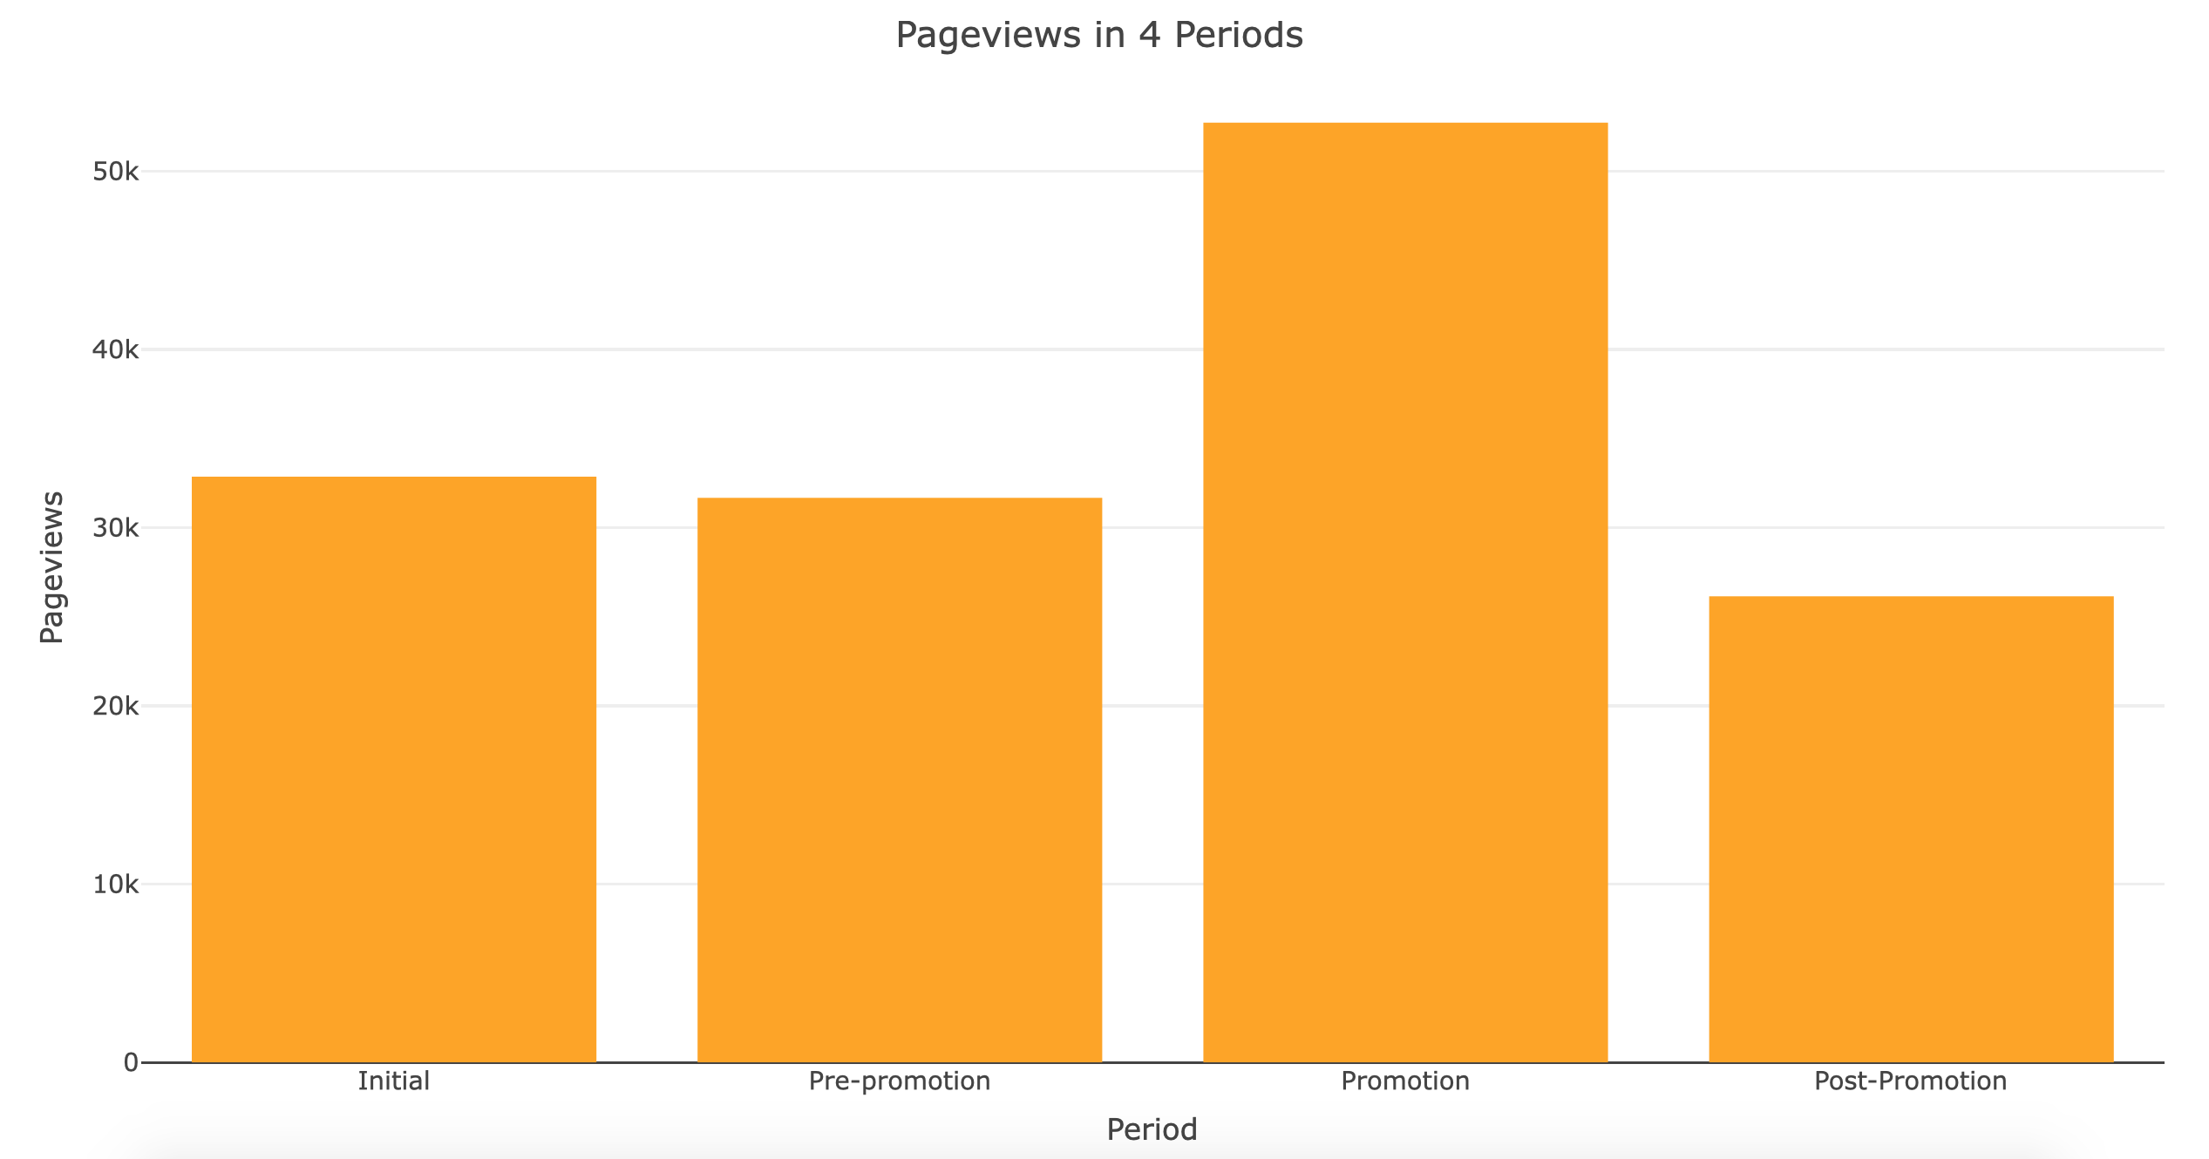
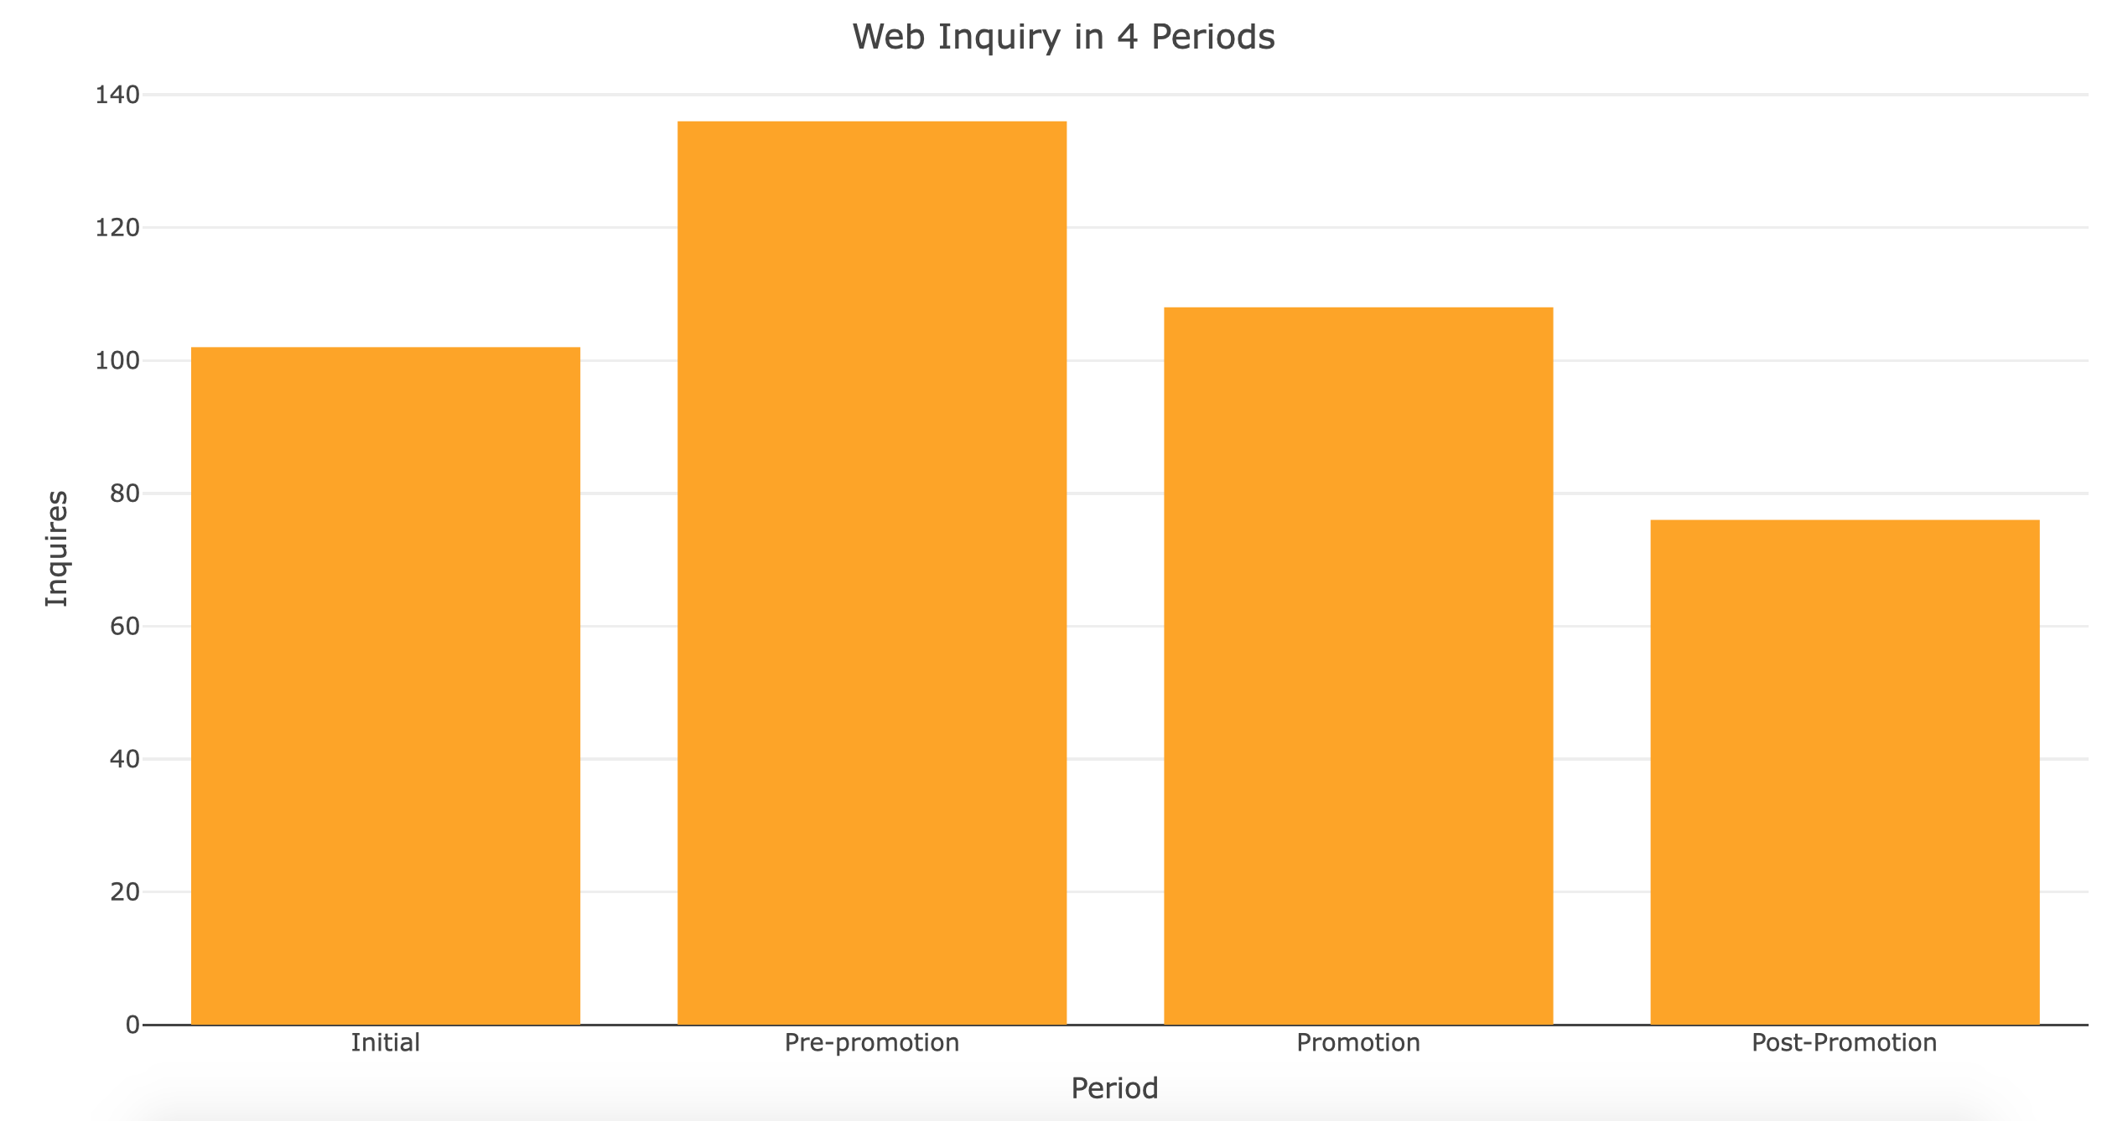
WEBSITE user usage
Pageviews in 4 Periods​
Web Inquiries in 4 Periods​
Promotion
Pre-
Promotion
Pre-
Promotion
Initial
Promotion
Initial
Post-
Promotion
Post-
Promotion
Pageviews did increase for the promotion period.
Web inquiries decreased from the pre-promo to the promotion period
Source: Columbia Business School - Web Analytics at Quality Alloys, Inc.
Notes:
Using the data from initial period to post promotion period, we can see that the number of page views significantly increased during the promotion period, and then dropped again to the same level as it was during the initial and pre promotion period. This graph tells us that sending the individual brochures did have an impact in making product and contact information available, adding legitimacy to their brand, and increasing website traffic. However, this does not mean that the promotion does, in fact, drive new sales.

Slide 7
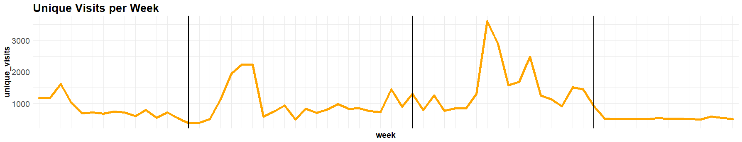
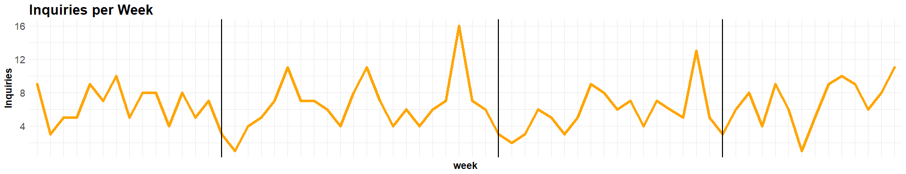
Web site visits
Comparison between Unique Visits vs Inquiries per week
Initial
Pre-Promo
Promo
Post-Promo
Source: Columbia Business School - Web Analytics at Quality Alloys, Inc.
Notes:
From May 2008 to August 2009, there is a stable trend on the overall number of unique visitors to QA's website. When the professionally produced brochures were sent to potential customers in promotion period, there was a slight increase in website traffic during the promotion period as we have also seen in the earlier graph on page views. However, the number of visits went back to normal after the promotion period.
On the other hand, the number of inquiries is relatively stable through the same time frame, without a significant change in trend during the promotion period. This leads us to the conclusion that traditional promotions do increase web traffic to a certain extent but does not generate enough interest or curiosity for visitors to actually explore the website's content and inquire about their products – which is what should supposedly lead to sales.

Slide 8

Promotion results Impact on Web Traffic, Mailing and Company Visualization
Variation of Unique Visits (AVG)
+236%
+77%
PROMOTION
VS
PRE-PROMOTION
PROMOTION
VS
OVERALL
Notes:
Promotion Period => - Margin (-2%) => - Revenue (-31%)
Promotion Period => + visits (+236%) => NO + sales (-2% margin , -3% Pounds Sold)

Slide 9

Promotion results Impact on Web Traffic, Mailing and Company Visualization
Bounce Rate (Data Quality) (AVG)
+30%
+10%
PROMOTION
VS
PRE-PROMOTION
PROMOTION
VS
OVERALL
B.R. AVG = 67%
B. R.PROMOTION AVG = 77%
Notes:
Promotion Period => - Margin (-2%) => - Revenue (-31%)
Promotion Period => + visits (+236%) => NO + sales (-2% margin , -3% Pounds Sold)

Slide 10
Promotion results Impact on Web Traffic, Mailing and Company Visualization
Bounce Rate Impact in Pound Sold
AVG Bounce Rate Dec 2008 = 39%
Pound Sold Dec 2008 VS 2007 = +26%
(Efficiency)
Notes:
Promotion Period => - Margin (-2%) => - Revenue (-31%)
Promotion Period => + visits (+236%) => NO + sales (-2% margin , -3% Pounds Sold)

Slide 11
Promotion results
Business Perspective (AVG Margin, Revenues, Costs)
45%
Promotion VS Overall
REVENUE
-5%
MARGIN
-2%
49%
43%
42%
Promotion VS Pre-Promo
REVENUE
-31%
MARGIN
-2%
Source: Columbia Business School - Web Analytics at Quality Alloys, Inc.
Notes:
Promotion Period => + visits (+236%) => NO + sales (-2% margin , -3% Pounds Sold)
- Revenue (-31%)

Slide 12




recommendations
Make the website more
user friendly
Change promotion strategy, is not having impact in revenues and profits.
Choose Google as service purchased to guide visits to the site
Focus Markets: North America and South America
Notes:
Conversion to sales: make the website more interesting for the audience.
Change the promotion strategy, is not having impact in revenues and profits.
Review the list purchased (25K) seems to be bad quality because of the bounce rate during the promotion period.
Choose Google as service purchased to guide visits to the site
Collect data regarding the conversion into sales of the visits --- this is in the further exploration
Look for possible clients from North America and South America because of the queries from those regions.

Slide 13
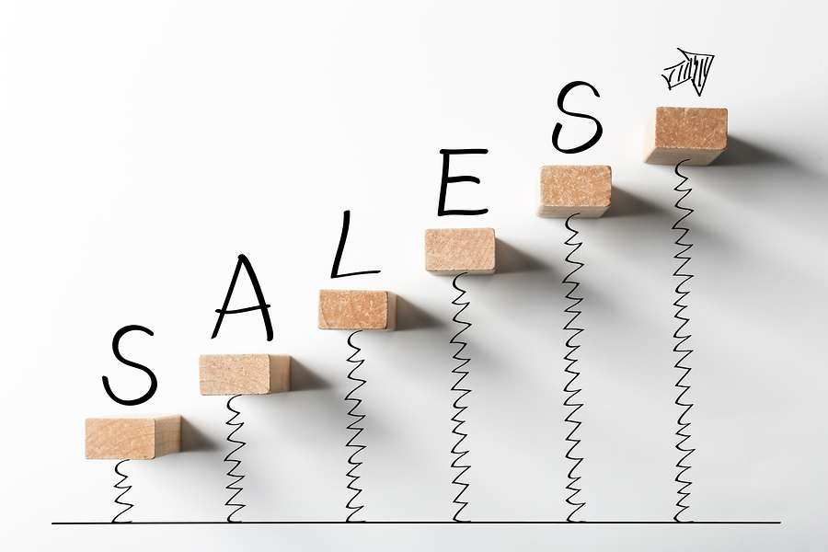
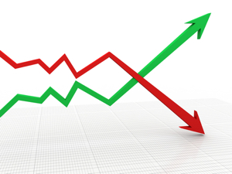


Further exploration
Collect more data regarding sales.
Collect data regarding variation of price in raw material
Conversion Rate based on the sources of leads
Measure the time it takes from inquiry to sales
Notes:
More data regarding to the sales and where they come from, to see the proportion of sales that come from new customers and from where they are from.
Look for the data regarding the variation of prices of the raw material to how this could also impact the profits, compare with revenue (sales).
Conversion to sales from the traffic sources purchased, like google, yahoo, etc.
Measure the time between the visit in the website and the pounds sold.

Slide 14
The End thank you

Slide 15
recommendations
Conversion to sales: make the website more interesting for the audience.
Change the promotion strategy, is not having impact in revenues and profits.
Review the list purchased (25K) seems to be bad quality because of the bounce rate during the promotion period.
Choose Google as service purchased to guide visits to the site
Collect data regarding the conversion into sales of the visits
Look for possible clients from North America and South America because of the queries from those regions.

Slide 16
Further exploration
More data regarding to the sales and where they come from, to see the proportion of sales that come from new customers and from where they are from.
Look for the data regarding the variation of prices of the raw material to how this could also impact the profits, compare with revenue (sales).
Conversion to sales from the traffic sources purchased, like google, yahoo, etc.
Measure the time between the visit in the website and the pounds sold.

Slide 17
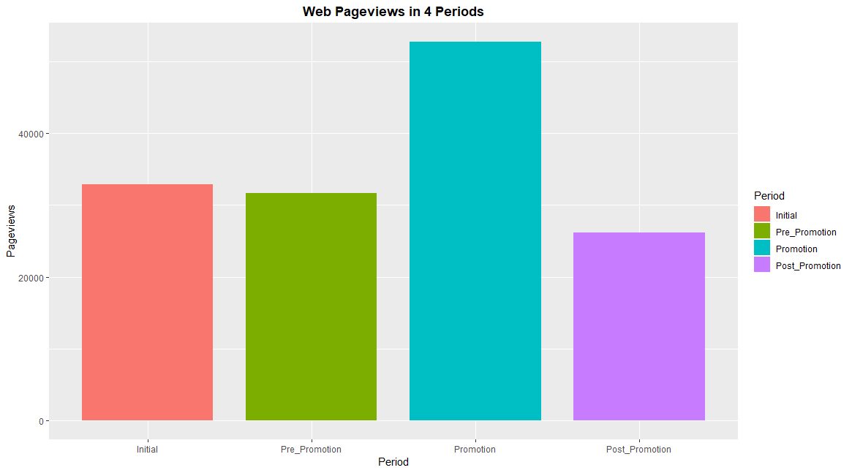
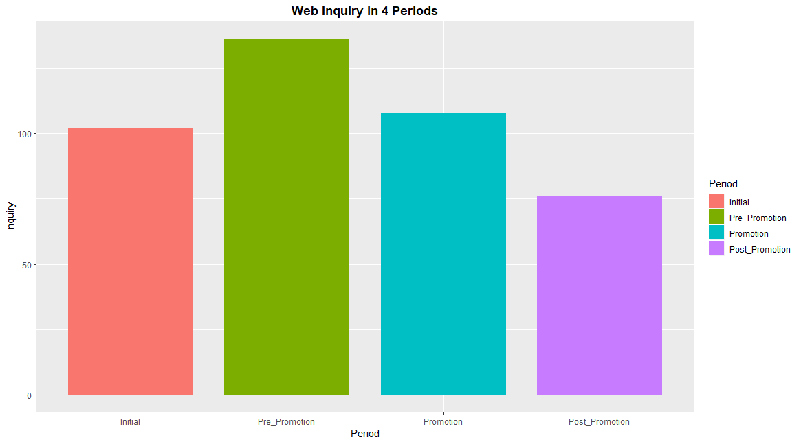
WEBSITE user usage
Web Pageviews in 4 Periods
Web Inquiry in 4 Periods
Promo
Pre Promo
Promo
Initial
Initial
Pre Promo
Post Promo
Post Promo
Notes:
Using the data from initial period to post promotion period, we can see that the number of page views significantly increased during the promotion period, and then dropped again to the same level it was during the initial and pre promotion period. This graph tells us that sending the individual brochures did have an impact in making product and contact information available, adding legitimacy to their brand, and increasing website traffic. However, this does not mean that the promotion does, in fact, drive new sales.

